Slide 1
Hyperparameter optimization using Optuna
Amit Saha
asah0916@uni.Sydney.edu.au
https://echorand.me

Slide 2
Hyperparameter tuning
ML algorithms have parameters and objective functions – which are optimized
Hyperparameter tuning is the process of intelligently searching the search space of the parameters via optimization algorithms

Slide 3
Hyperparameter tuning using Optuna
ML algorithm agnostic
Study – set up range of the parameters, which sampling (optimization algorithm) algorithm to use, and whether to maximize or minimize objectives
Trial – a single run of the ML algorithm + the parameters chosen from the study configuration

Slide 4
Demos
Xgboost + UCI adult dataset

Slide 5
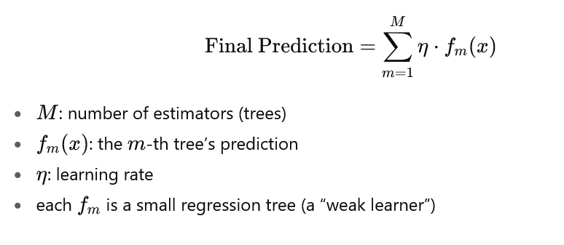
xgboost

Slide 6
Creating a study
def create_study(
*,
storage: str | storages.BaseStorage | None = None,
sampler: "samplers.BaseSampler" | None = None,
pruner: pruners.BasePruner | None = None,
study_name: str | None = None,
direction: str | StudyDirection | None = None,
load_if_exists: bool = False,
directions: Sequence[str | StudyDirection] | None = None,
) -> Study:

Slide 7
Creating a study – single objective
def create_study(
*,
storage: str | storages.BaseStorage | None = None,
sampler: "samplers.BaseSampler" | None = None,
pruner: pruners.BasePruner | None = None,
study_name: str | None = None,
direction: str | StudyDirection | None = None,
load_if_exists: bool = False,
directions: Sequence[str | StudyDirection] | None = None,
) -> Study:

Slide 8
Objective function – single objective

Slide 9
Creating a study – bi-objective
def create_study(
*,
storage: str | storages.BaseStorage | None = None,
sampler: "samplers.BaseSampler" | None = None,
pruner: pruners.BasePruner | None = None,
study_name: str | None = None,
direction: str | StudyDirection | None = None,
load_if_exists: bool = False,
directions: Sequence[str | StudyDirection] | None = None,
) -> Study:

Slide 10
Objective function – multi objective

